Slide 1
Presentation on
Cause of Deaths(world wide)
Submitted by:
P Naga Suvarchala
Data Science Intern
Flip Robo Technologies

Slide 2
Introduction:
Data Science can be used to study and analyze patterns in data related to causes of death, such as analyzing mortality rates, identifying risk factors, and discovering trends in health outcomes.
This information can be used to develop strategies for preventing or mitigating certain causes of death and improving overall health outcomes.
Data Science can play a role in understanding and predicting causes of death by analyzing large datasets such as health records, demographic information, and lifestyle habits.
This can help identify patterns and risk factors, and support the development of evidence-based policies and interventions to prevent deaths from specific causes. Additionally, machine learning techniques can be applied to predict individual outcomes based on past experiences, which can help in early diagnosis and treatment of diseases.

Slide 3
Context
A straightforward way to assess the health status of a population is to focus on mortality – or concepts like child mortality or life expectancy, which are based on mortality estimates.
A focus on mortality, however, does not take into account that the burden of diseases is not only that they kill people, but that they cause suffering to people who live with them. Assessing health outcomes by both mortality and morbidity (the prevalent diseases) provides a more encompassing view on health outcomes.
This is the topic of this entry. The sum of mortality and morbidity is referred to as the ‘burden of disease’ and can be measured by a metric called ‘Disability Adjusted Life Years‘ (DALYs). DALYs are measuring lost health and are a standardized metric that allow for direct comparisons of disease burdens of different diseases across countries, between different populations, and over time. Conceptually, one DALY is the equivalent of losing one year in good health because of either premature death or disease or disability.
One DALY represents one lost year of healthy life. The first ‘Global Burden of Disease’ (GBD) was GBD 1990 and the DALY metric was prominently featured in the World Bank’s 1993 World Development Report.
Today it is published by both the researchers at the Institute of Health Metrics and Evaluation (IHME) and the ‘Disease Burden Unit’ at the World Health Organization (WHO), which was created in 1998. The IHME continues the work that was started in the early 1990s and publishes the Global Burden of Disease study.

Slide 4
Content
In this Dataset, we have Historical Data of different cause of deaths for all ages around the World.
The key features of this Dataset are:
Meningitis, Alzheimer's Disease and Other Dementias,
Parkinson's Disease, Nutritional Deficiencies,
Malaria, Drowning,
Interpersonal Violence, Maternal Disorders,
HIV/AIDS, Drug Use Disorders,
Tuberculosis, Cardiovascular Diseases,
Lower Respiratory Infections, Neonatal Disorders,
Alcohol Use Disorders, Self-harm,
Exposure to Forces of Nature, Diarrheal Diseases,

Slide 5
Environmental Heat and Cold Exposure, Neoplasms,
Conflict and Terrorism, Diabetes Mellitus,
Chronic Kidney Disease, Poisonings,
Protein-Energy Malnutrition, Road Injuries,
Chronic Respiratory Diseases, Cirrhosis and Other Chronic Liver Diseases,
Digestive Diseases, Fire,
Heat, and Hot Substances, Acute Hepatitis.

Slide 6
Objectives of the study
Study & Exploratory Data Analysis (EDA) of Cause of Deaths in dataset
To perform tasks of Summary Statistics & Correlation factor of the problem dataset.
To perform data pre-processing of the dataset and perform Mathematical/ Analytical Modeling of the Problem in order to train the model.
Formulate Model/s Development, Evaluation and Testing of Identified Approaches.
Visualizations , Interpretation of the Results.

Slide 7
Software Requirements and Tools Used
Software Tools used:
Programming language: Python
Distribution: Anaconda Navigator
Browser-based language shell: Jupyter Notebook
Libraries/Packages Used:
Pandas
Numpy
Matplotlib
Seaborn
Scipy.stats
Sklearn

Slide 8
Mathematical/ Analytical Modelling of the Problem
The provided dataset is in XLs format. We will begin with loading the dataset and reading the dataset from the XLs file using the read_xls() function from the Pandas Python package.
Next, we will perform Non-Graphical Exploratory Data Analysis (EDA) such as checking the data types and missing values using pandas info() function, Then, we will get statistical information about the numeric columns in our dataset using pandas.DataFrame.describe() method.
After that, we will move on to perform graphical EDA to get more insights from our dataset and how the feature attribute affects the target attribute.

Slide 9

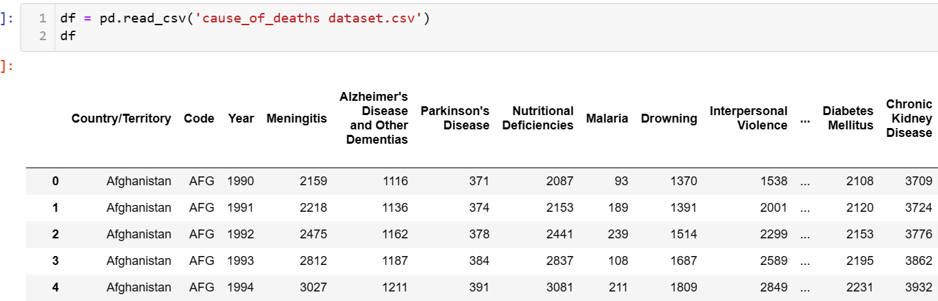
Working with the Dataset
Loading DataSet

Slide 10

Data Sources and their formats
Observation -
There is 6120 rows and 34 columns in dataset

Slide 11
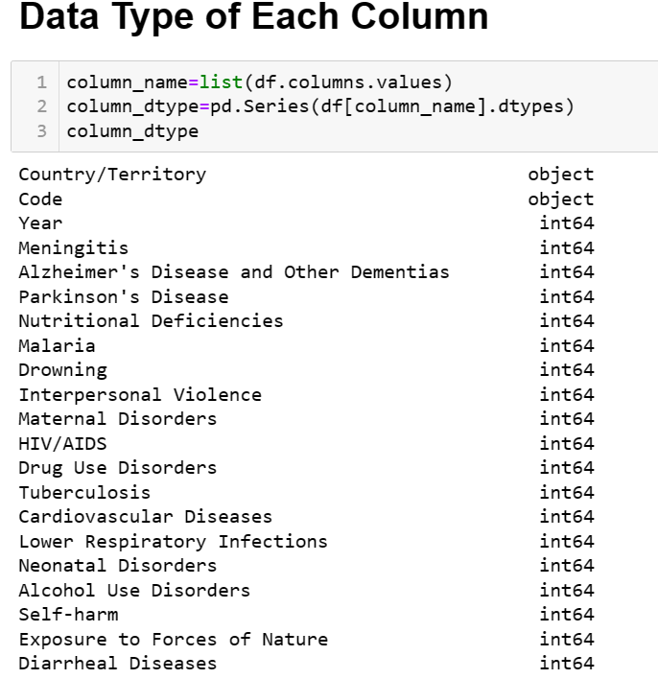
Data Type and Information
Observations:
All are numeric columns except – Country name and Country code.

Slide 12
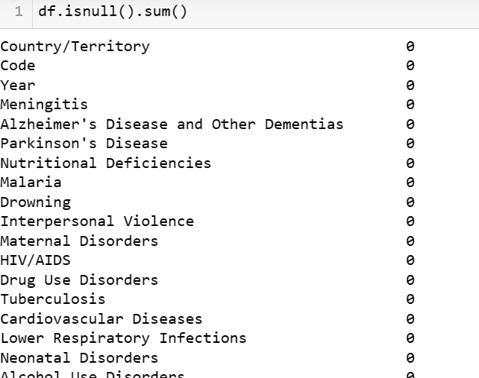
Missing Values: There is no missing values in dataset

Slide 13
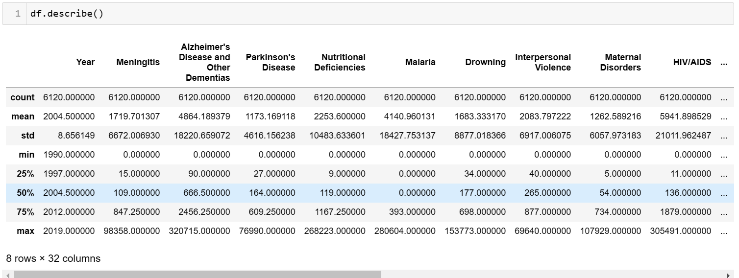
Statistical Summary of DataSet

Slide 14
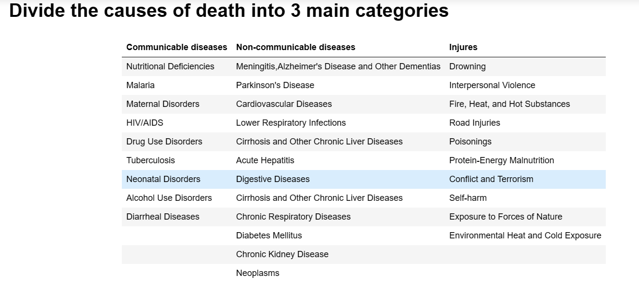
Exploratory Data Analysis:

Slide 15
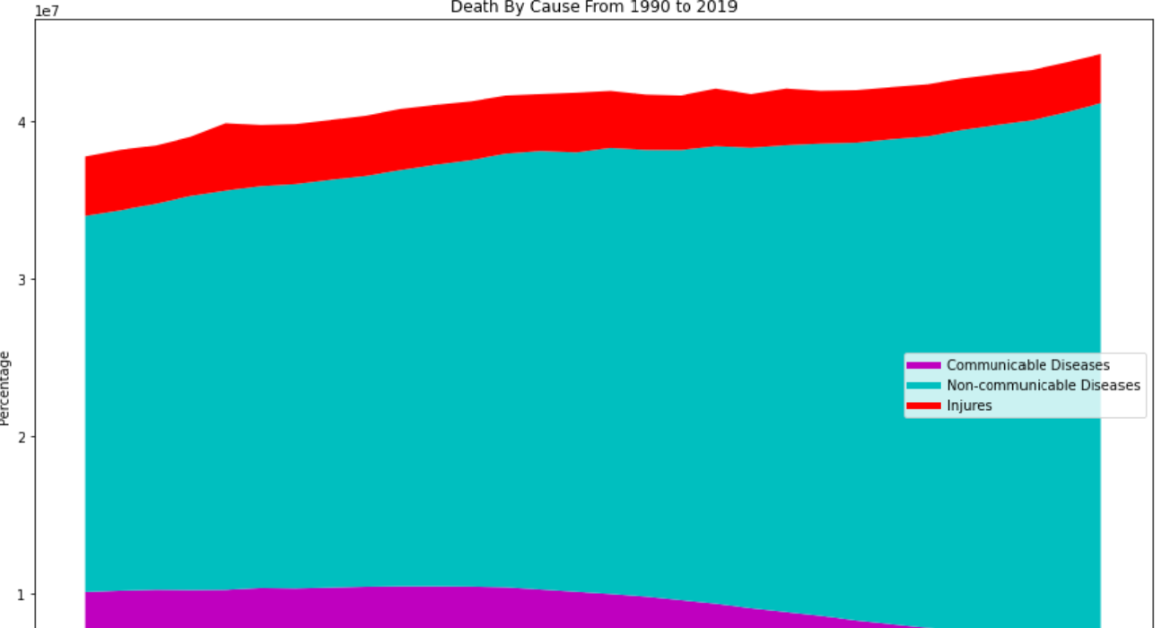
Death causes from 1990 to 2019

Slide 16
Observations:-
During the 30 years from 1990 to 2019, the following trends were observed:
The number of deaths from non-communicable diseases always accounts for the highest rate and tends to increase gradually.
The number of deaths from communicable diseases accounts for the lowest rate, and maintains a fairly stable number over the years.
The number of deaths from injures accounts for a high rate, but tends to decrease.

Slide 17
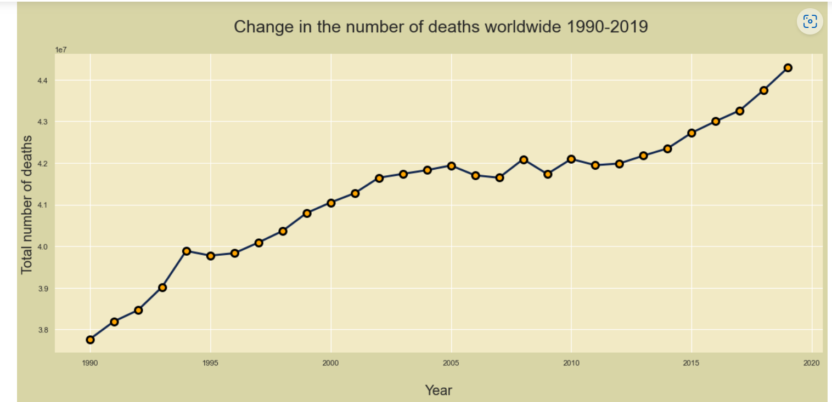

Slide 18
Observations:-
The number of deaths in the world tends to increase each year, proportional to the population growth. Realizing that countries with a large population have a died and vice versa.
Leading in the world in the number of deaths is: China, India, United States, Russia, Indonesia (whether in 1990 or 2019, these countries are still at the top of the number of deaths).

Slide 19
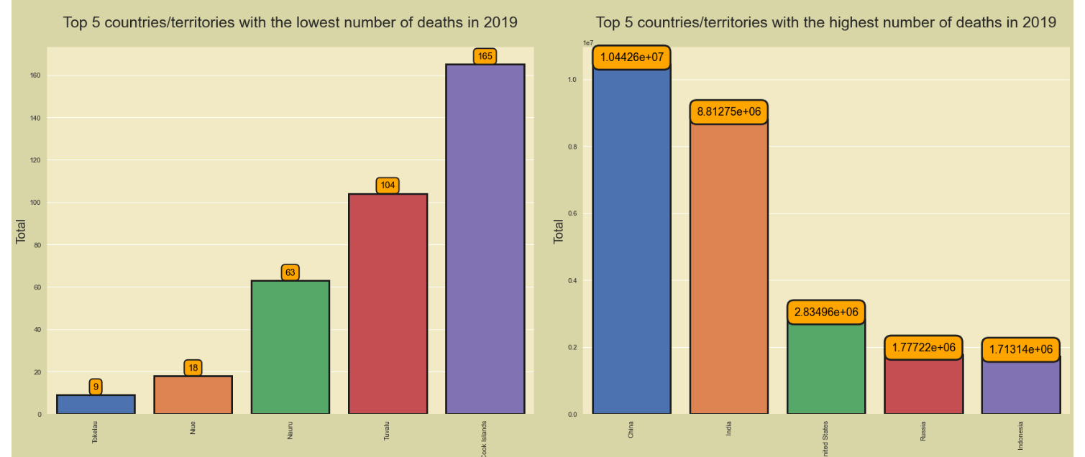
Top 5 countries/territories with the lowest/highest number of deaths in 2019

Slide 20
Observation:-
The countries/territories with the highest or lowest number of deaths in 2019 are directly proportional to their population. This is considered reasonable.
Top 5 countries/territories with the highest number of deaths in 2019
Country/Territory | Population | Deads
China | 1433783686 | 10442561
India | 1366417754 | 8812747
United States | 328239523 | 2834964
Russia | 145872256 | 1777223
Indonesia | 273523615 | 1713143

Slide 21
Top 5 countries/territories with the lowest number of deaths in 2019
Country/Territory | Population | Deads
Tokelau | 1340 | 9
Niue | 1615 | 18
Nauru | 10756 | 63
Tuvalu | 10956 | 104
Cook Islands | 17548 | 165

Slide 22
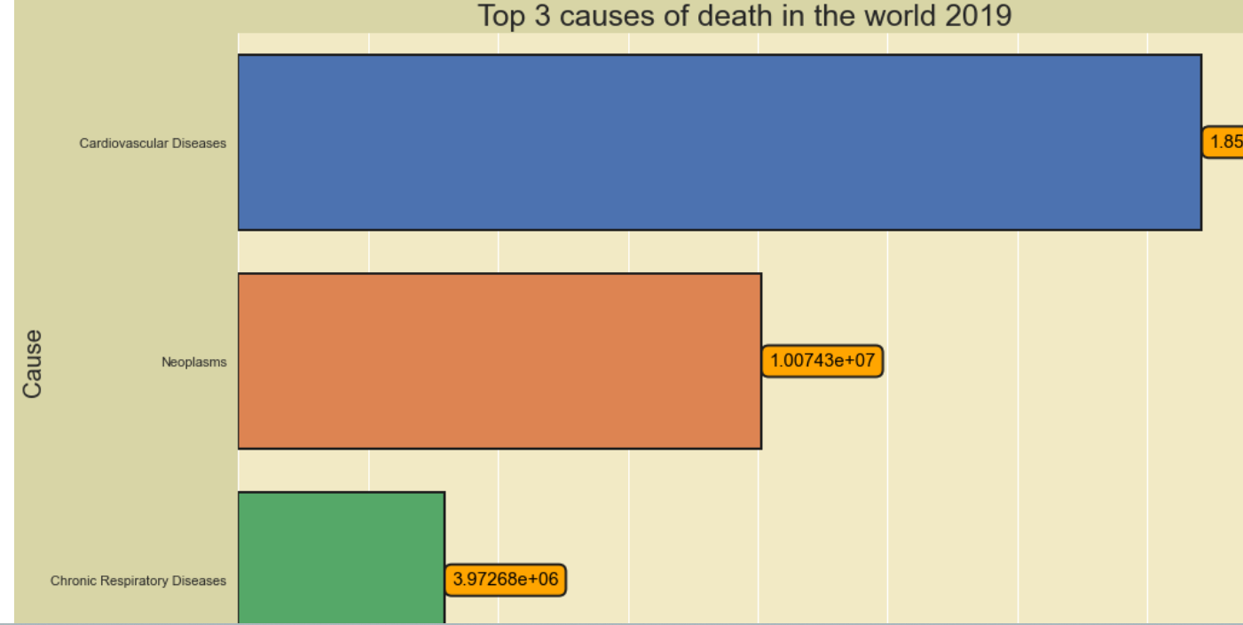

Slide 23
Observation:-
In 2019:
The number of deaths from Cardiovascular problems reached 18552218 people, accounting for the highest proportion.
Taking the top 2 position is Neoplasms, with 10074275 deaths. Taking the top 3 position is Chronic Respiratory Diseases, with 3972681 deaths.

Slide 24
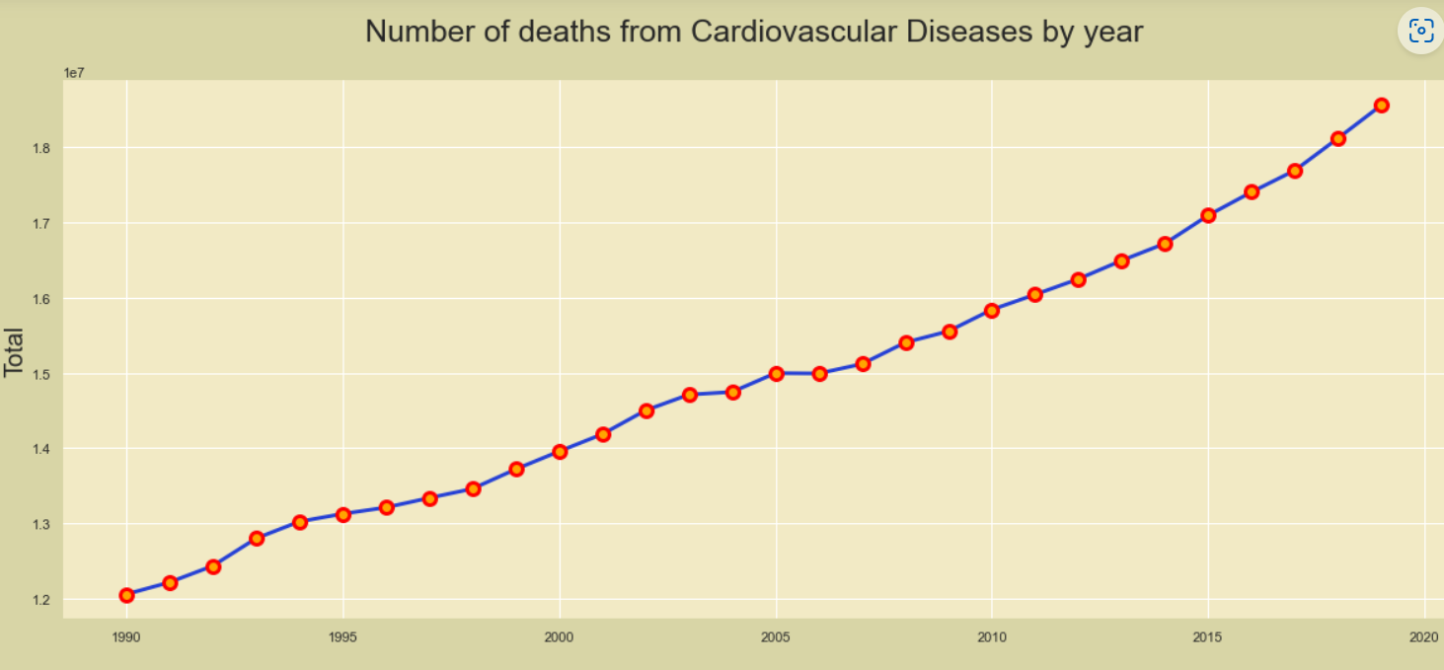

Slide 25
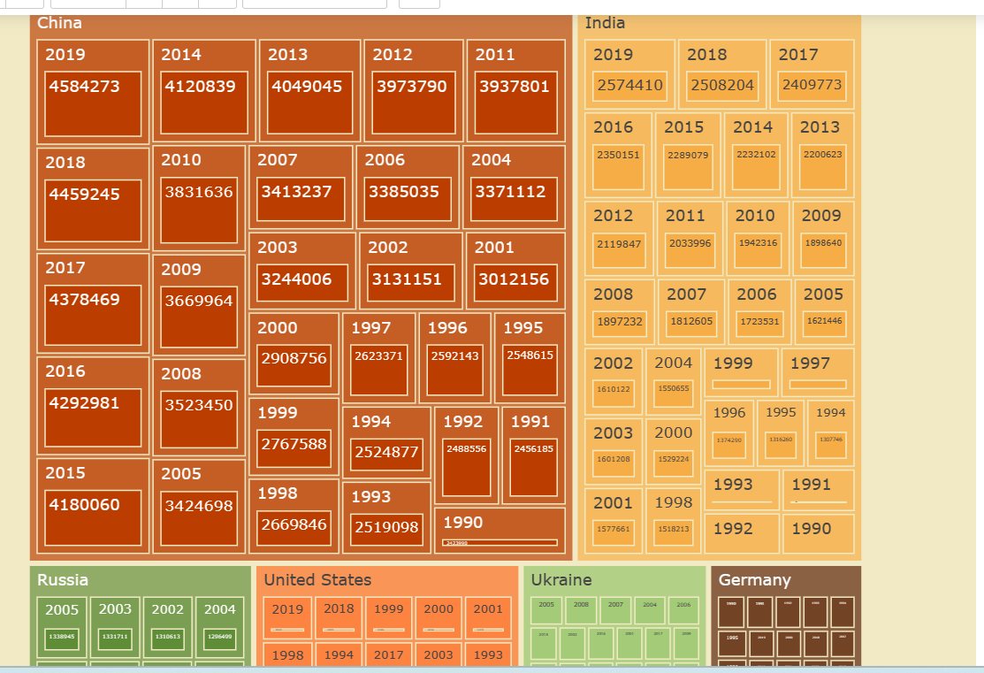
Countries with highest no of deaths from cardiovascular disease

Slide 26
Observation:-
Cardiovascular disease remains the leading burden of disease
The number of deaths related to cardiovascular problems increases year by year, accounting for the highest proportion of all causes. Especially in countries with large populations and developed economies.
According to WHO data, heart disease is the largest cause of death in the world. In which, ischemic heart disease accounted for 16% and stroke accounted for 11% of global deaths. Since 2000, the number of deaths from the disease has increased the most, increasing by more than 2 million to 8.9 million deaths in 2019.
Especially in the current situation of COVID-19 epidemic, the risk of death often focuses mainly on the elderly population, with underlying medical conditions such as hypertension, cardiovascular disease and other chronic diseases. Data from Wuhan (China) show that the mortality rate accounts for 10.5% in people with COVID-19 with heart disease, 7.3% in people with diabetes, 6.3% in people with diabetes. people with respiratory disease and 6% in those with hypertension. On the other hand, worries about the epidemic situation and people's travel restrictions have led to cardiovascular patients delaying their follow-up visits. This is really dangerous for general chronic illness, which often has no obvious symptoms or signs.

Slide 27
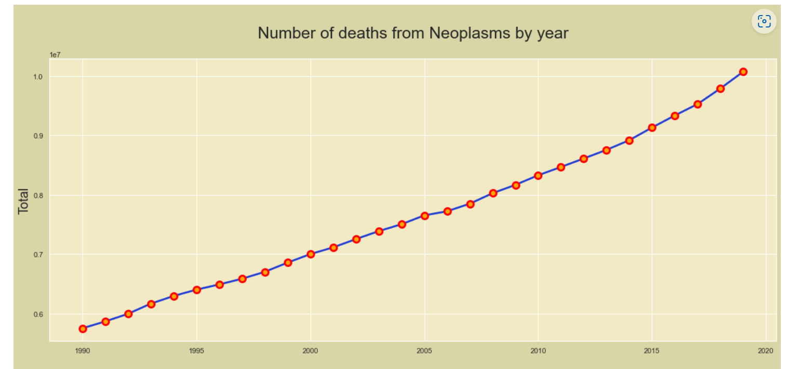

Slide 28
Observation:-
Neoplasms - Cancer Rates of new cancer and cancer deaths continue to increase year by year. Cancer is not a disease, but a group of diseases. To date, about 200 different types of letters on the human body have been identified.
Below is a list of some of the most common types of cancer:
Lung cancer: accounts for the highest rate in men, including developed and developing countries (accounting for 12.4% of all cancers). Mortality and morbidity rates increase from age 40 and older and peak at age 75. Lung cancer mortality is estimated to be the sum of the four types of colorectal, breast, prostate, and prostate cancers. pancreas.
Stomach cancer: an estimated 934,000 new cancer patients are diagnosed each year. There are many causes of stomach cancer, but an estimated 30% of new cases in developed countries and 47% in developing countries are related to Helicobacter Pylori. Some regions such as Southeast Asia, South America, Eastern Europe... have higher rates of stomach cancer than other regions in the world.
Breast cancer: is the most common cancer in women (accounting for about 23% of all cancers), especially women in developing countries. The rate of breast cancer increases at the age of 50, 60 and peaks at the age of 70. The incidence is expected to be 111 per 100,000 population in the early years of the 21st century.
Colorectal cancer: accounts for about 9.4% of all cancers. This type of cancer is often related to diet and living standards..., the disease is more common in developed countries than in poor countries. The disease has a genetic component. The risk of colorectal cancer is increased in people with a pre-existing history of colitis.
Liver cancer: accounts for about 5.7% of all cancers and is closely related to a history of hepatitis B and C. Asian countries have high rates of liver cancer.

Slide 29
Prostate cancer: the disease is common in the elderly, tends to increase due to the increasing life expectancy. An estimated 679,000 people are newly diagnosed with the disease every year. The prevalence is high in developed countries and lower in developing countries.
Cervical cancer: an estimated 493,000 new cases every year. Human papilloma virus (HPV) is probably one of the risk factors for this disease in poor and developing countries.

Slide 30
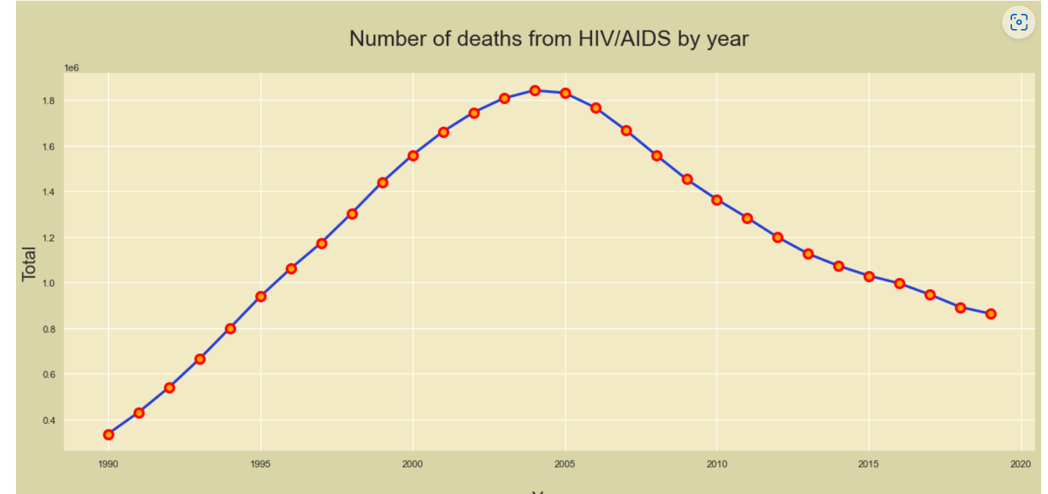

Slide 31
Observation:-
HIV/AIDS
HIV-1 originated in Central Africa in the first half of the 20th century, when a chimpanzee linked to the virus first infected humans. The global epidemic began in the late 1970s, and AIDS was recognized in 1981.
The annual decline in HIV infections, which dropped especially sharply after 2004, is largely due to efforts to increase the number of people living with HIV who know their HIV status and are virally suppressed - meaning their HIV infection is being suppressed. control through effective treatment. This is a top public health priority. Studies have shown that, in addition to improving the health of people with HIV, early treatment with antiretroviral drugs significantly reduces the risk of transmitting the virus to others.

Slide 32
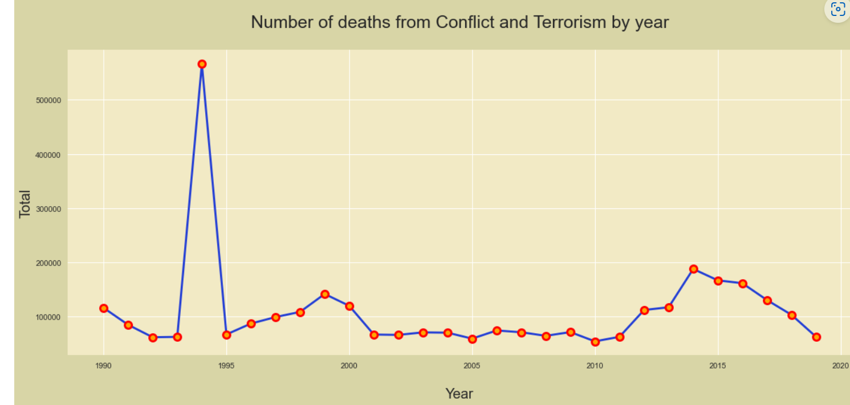

Slide 33
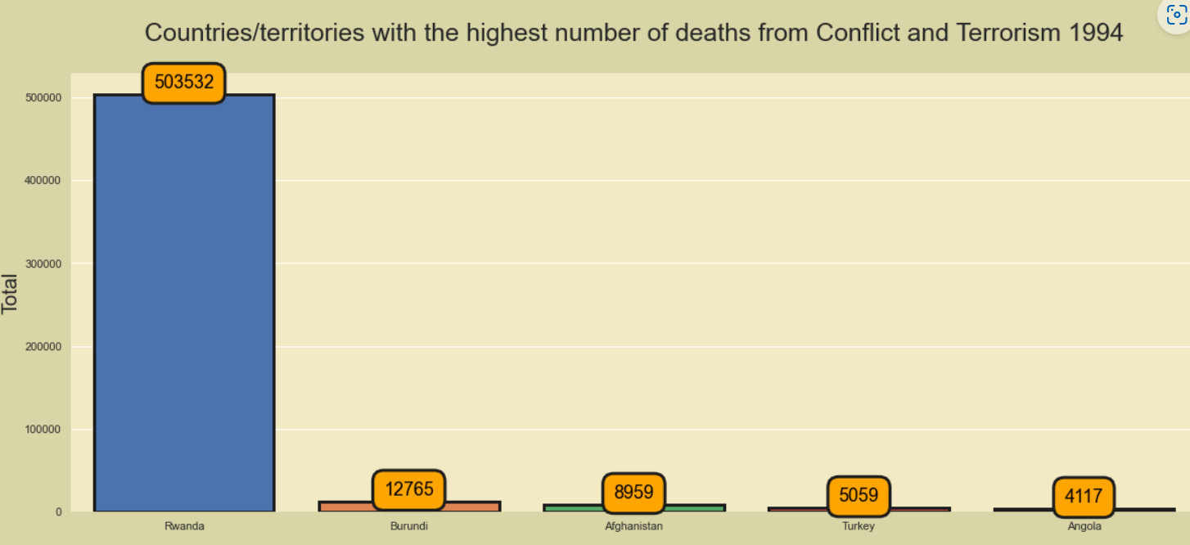

Slide 34
Observation:-
In 1994, the number of deaths from Conflict and Terrorism skyrocketed in Rwanda
Cause: The Rwandan genocide occurred between 7 April and 15 July 1994 during the Rwandan Civil War. During this period of around 100 days, members of the Tutsi minority ethnic group, as well as some moderate Hutu and Twa, were killed by armed Hutu militias. The most widely accepted scholarly estimates are around 500,000 to 662,000 Tutsi deaths.

Slide 35
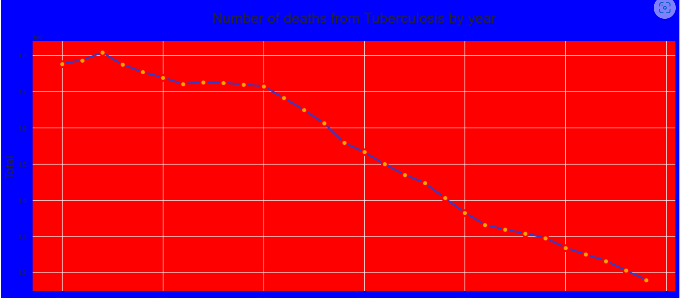

Slide 36
Observation:-
Tuberculosis
Tuberculosis dates back to BC. In the past, due to the lack of understanding of the cause of TB, TB was considered a genetic disease. On Sunday, March 24, 1992, a German doctor named Robert Koch announced the discovery of tuberculosis bacteria. At that time TB was ravaging Europe and America with a rate of 1 out of 7 people alive and dying from TB. Thus, on the line graph we see a spike in TB deaths in 1992.
After 19992, ushered in a new era of TB understanding, advances in TB detection, diagnosis and treatment. Looking at the graph, we can see that the number of deaths from TB decreased significantly after 1992.

